Slide 1
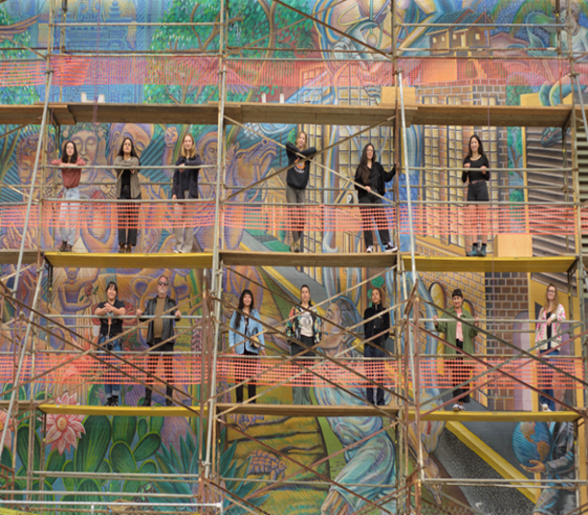
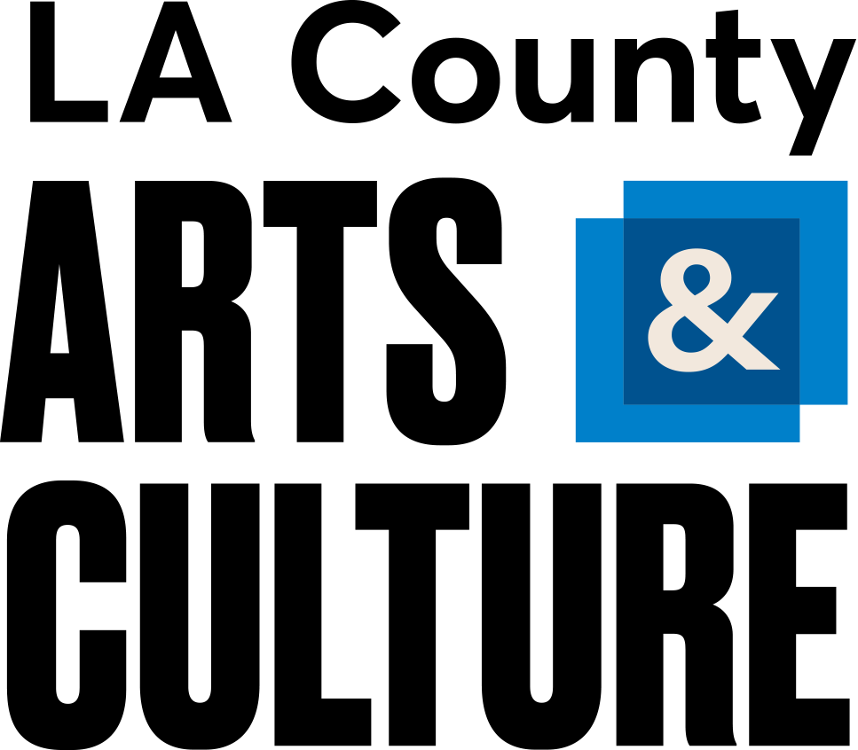
LA County Department of Arts and Culture
2028 Cultural Program Framework
Informational Hearing:
Cultural Olympiad/Arts & Cultural Plans
Director, Kristin Sakoda
October 14, 2026

Slide 2
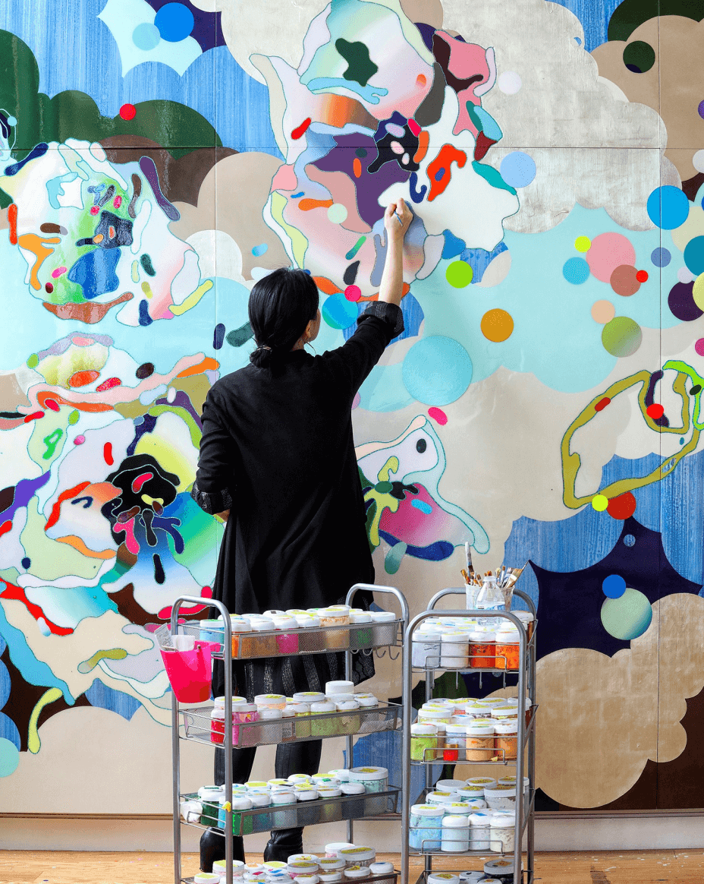
Mission
To advance arts, culture, and creativity throughout Los Angeles County.
Vision
We envision a region in which arts, culture, and creativity are integral to every aspect of civic life for all people and communities.
Programs and Services
Grants and Professional Development
Civic Art Collection, Care, Commissions
Arts Education and Youth Development
Cross-Sector Arts Strategies
Research and Evaluation
Communications
We are home to Arts Commission, Arts Education Collective,
LA City/County Native American Indian Commission

Slide 3
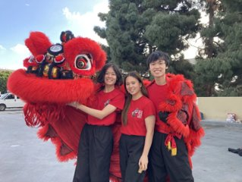
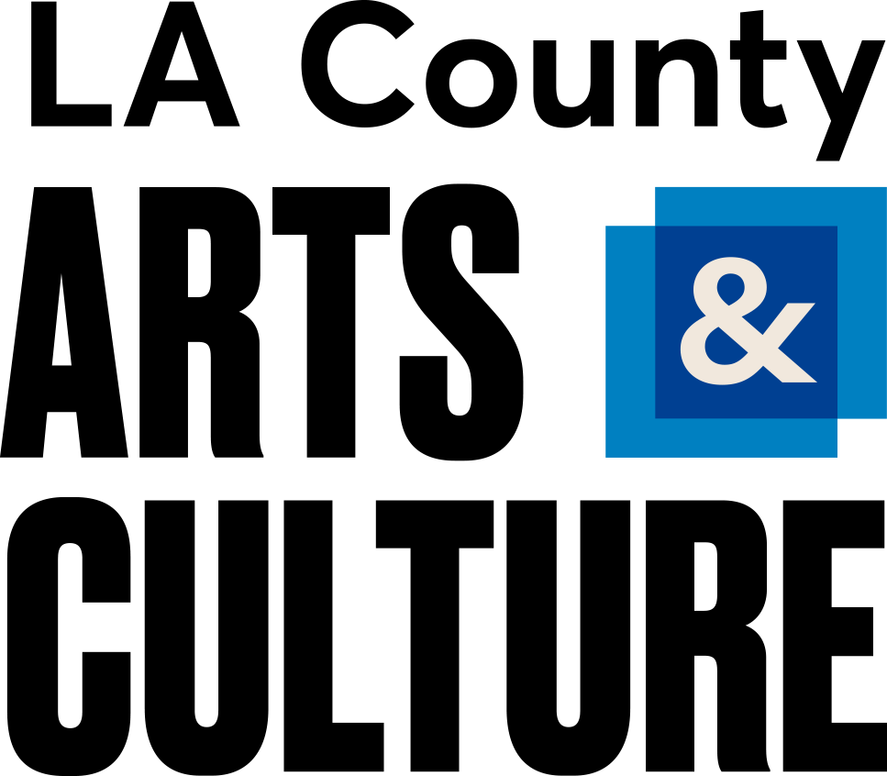
2028 Vision:
Arts and Culture for All
We envision the 2028 Olympic and Paralympic Games as an opportunity to inspire, connect, engage, and strengthen communities through a dynamic cultural program that celebrates creative expression, champions arts and culture, uplifts LA’s cultural heritage, and reflects diverse voices of the LA County region in the global spirit of the Games, with lasting legacy benefits for our arts sector and local communities beyond 2028.

Slide 4
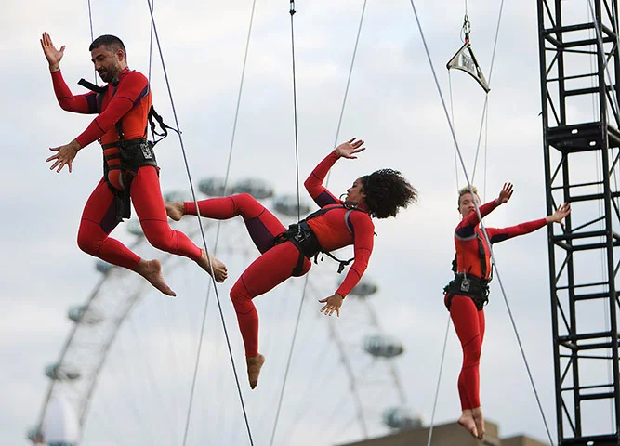
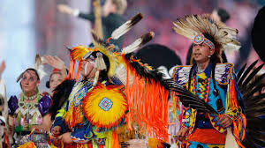
  Arts and Culture Highlights from Prior Games
STREB, 2012 Olympics; London
2010 Winter Olympics;
Vancouver
1984
Los Angeles
Seoul
Barcelona
Atlanta
Sydney
Athens
Beijing
London
Rio de Janeiro
Tokyo
2024 Paris

Slide 5
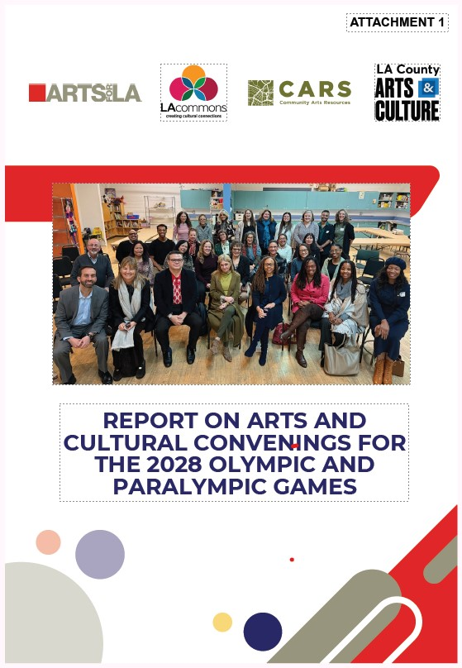
Cultural Sector Games Convenings – What We Heard
We have convened over 300 arts and cultural field leaders
Primary target audience for arts and culture organizations:
Local residents (70%) vs International visitors (30%)
Top ways to reach audiences through arts programming:
Art installations and performance in public space
Community-based festivals and events
Cross-cultural collaboration via local and international artists
Top strategies for authentic representation and inclusion:
Direct funding to community-based arts organizations
Create neighborhood or region-specific cultural hubs
Support marketing and visibility in arts and culture
Clear pathways to participation, and special attention on:
Disability inclusion, Native cultures, LA's cultural diversity
Barriers / opportunities (e.g. marketing, geography, access)

Slide 6
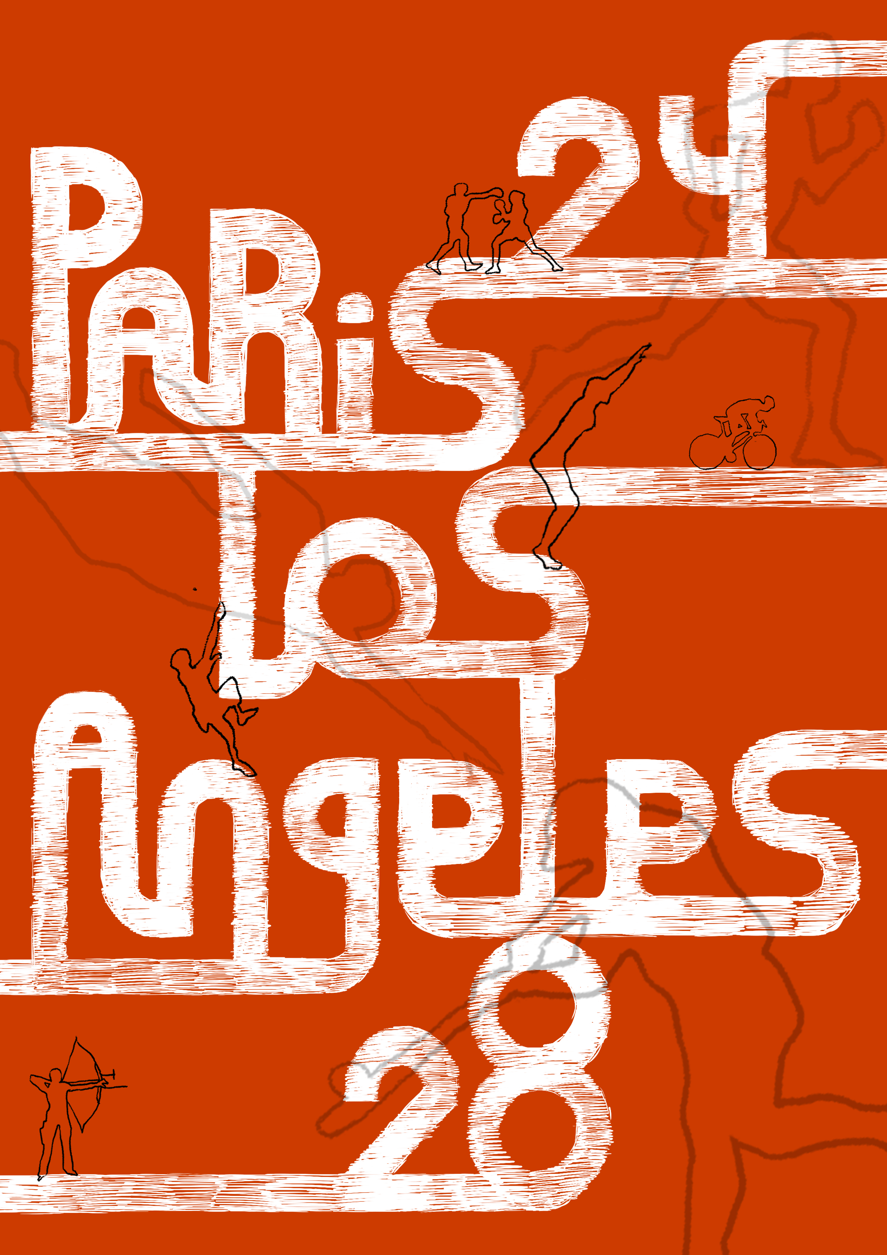
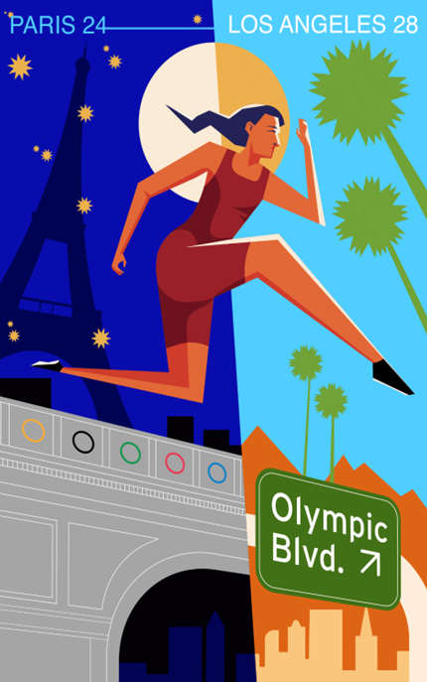
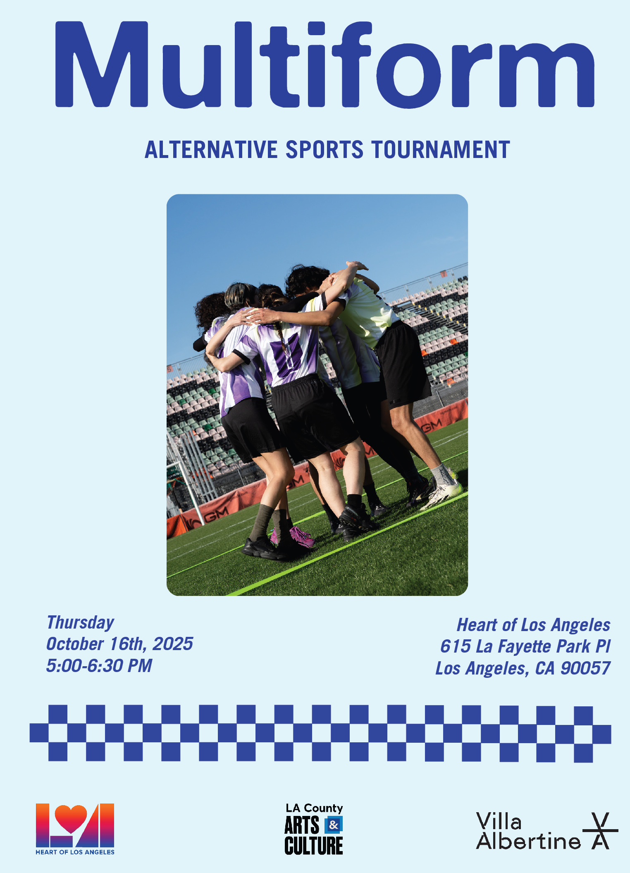
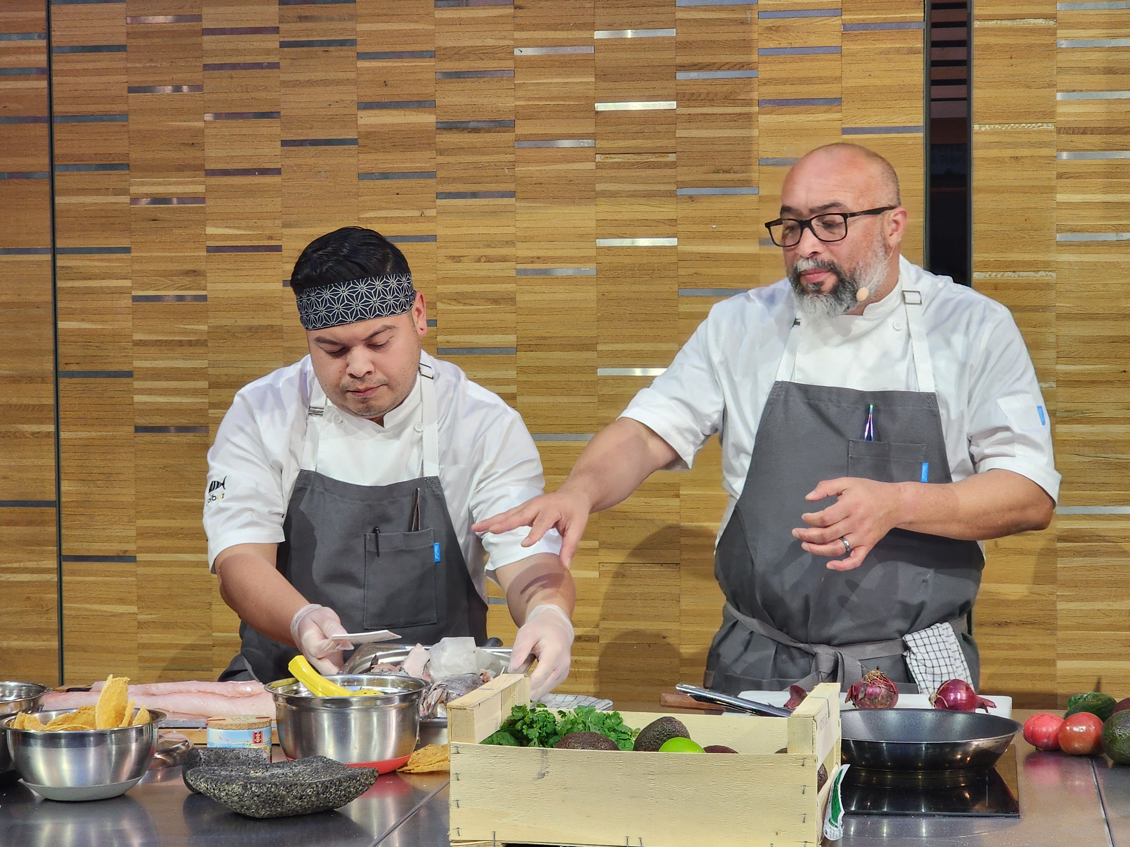


Cultural Exchange, Diplomacy, and Artistic Collaborations

Slide 7
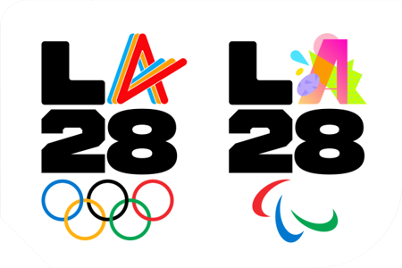
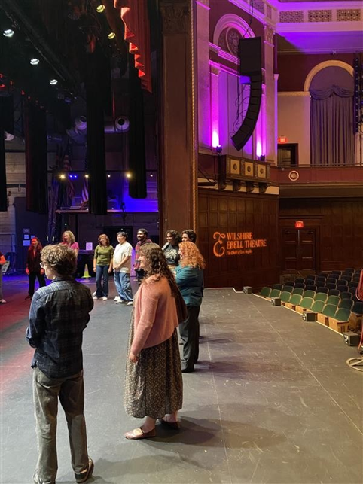
Key Partner Roles & Engagement
LA28:
Responsible for the official LA28 "Cultural Olympiad"
Application for Cultural Olympiad "mark" early 2027
Will market its activities and approved cultural events
LA28 and City coordinate but remain distinct programs
LA City:
DCA leads host City 2028 Cultural Program framework
Activating artists, organizations, and communities citywide
LA County:
Advances arts, culture, and creativity across LA region as a funder, convener, partner, program lead, and connector
Department leads County 2028 Cultural Program framework
County named as key partner by both LA City and LA28
Field-Wide Stakeholders:
Alignment, coordination, and collaboration with municipalities, regional initiatives, funders, arts organizations, and partners.

Slide 8
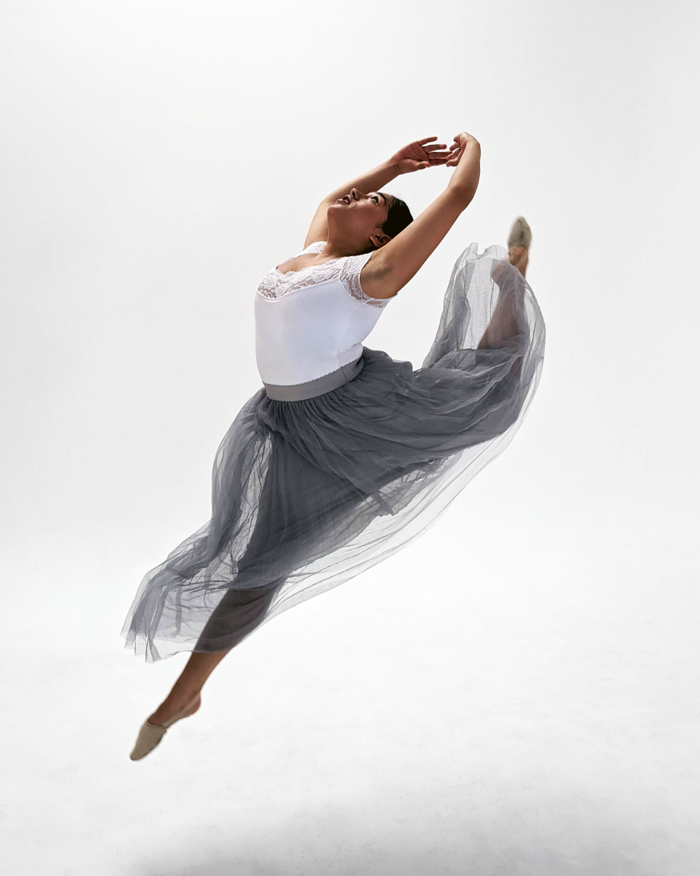
Arts & Culture 2028 Goals
1. Showcase LA County's Arts and Culture
Tell the story of the LA region's cultural diversity, heritage, art, artistry, and creativity, locally and on the global stage
2. Expand Arts Access to Engage Communities
    Engage diverse communities with wide arts access, programming, & cultural participation for local audiences, visitors, viewers
3. Spark New Collaborations and Exchange
Spark new collaborations, ways of working, & partnerships within the LA arts field, internationally, and across culture, sports, education
4. Strengthen the Arts and Cultural Sector
Strengthen the cultural sector, investment in the arts, creative economy, and cultural infrastructure of Los Angeles County
5. Create a Lasting Legacy for the LA Region
Create a lasting legacy beyond the Games with cross-sector benefits for arts and the civic life of our communities
Young Choreographers Project

Slide 9
2028 Programmatic Pillars Reflect Region's Strategies
1. Arts & Culture Programs for All
2. Youth Arts Engagement
3. Public Art & Culture in Place
4. Arts All Access Communications
Expand access to the arts through cultural programs, exhibits, performing arts, and events — enlivening joy, civic engagement, social connection, economic activity, learning, and cultural diversity.
Young people engage in arts, learning, play, and creativity — in schools, communities, civic spaces, and institutions — as a celebration of young talent, creative expression, LA's cultural diversity, and the Games.
Creative placemaking and keeping use transformative role of arts and culture to celebrate diverse cultures, support local creative economies, build social cohesion, and create vibrant spaces of creative activity, wellbeing, and belonging.
Communications, marketing, storytelling, and visual strategies are needed to boost the visibility of arts organizations, ensure wide arts access, and spotlight stories of LA’s artistry, creativity, and culture.

Slide 10
Pillar 1: Arts and Culture for All
Public Programs, Exhibits, Live Arts, and Cultural Events
Flexible Grants for Arts Organizations, via the Organizational Grant Program and Community Arts Impact Grants Program,
within existing budget allocation.
County grants support 600+ nonprofits, reflect and serve region's diverse communities and art forms.
County collaborations, engaging LA County-owned cultural institutions and venues, and County departments, for programs and cross-promotion.
Notes:
Anji speaks

Slide 11
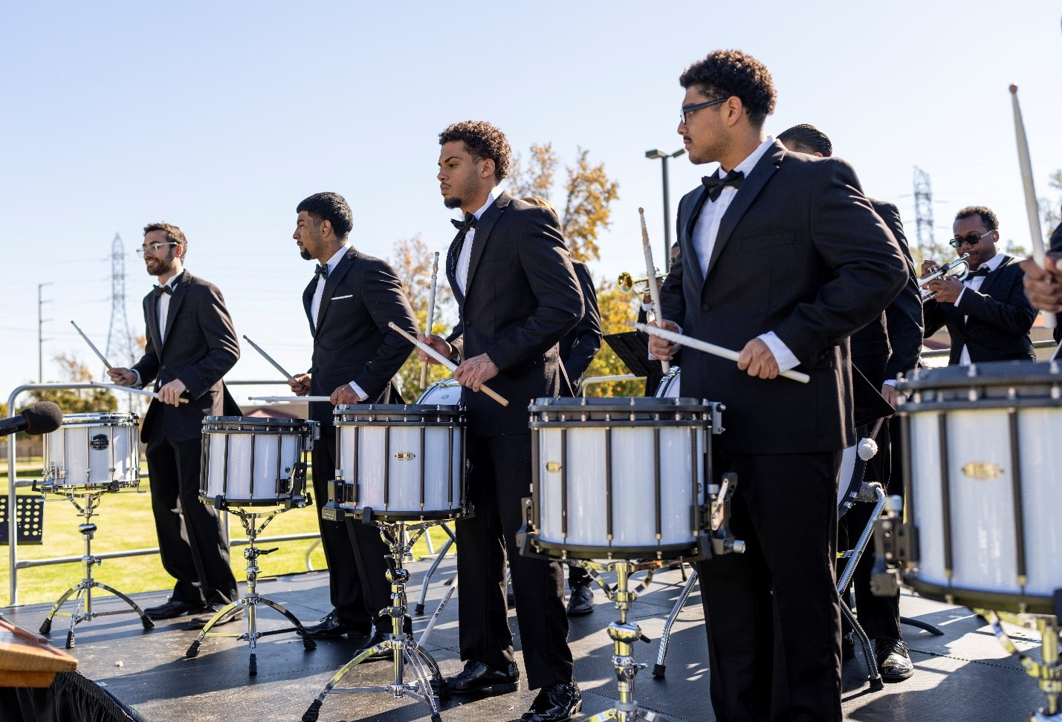
Pillar 2: Year of Creative Youth
Building a Youth Arts Legacy
Fall 2027 through Summer 2028 young people across LA County will engage in arts, learning, play, and creativity — in schools, communities, civic spaces, and institutions — as a celebration of young talent, creative expression, LA's cultural diversity, and the Games.
Arts is youth development, mental health, education, and creative career pathways.
Anchored by the County's youth arts programs,
Year of Creative Youth envisions participation by partners across the LA region.
Inner City Youth Orchestra, Barry J. Nidorf Secure Youth Treatment Facility (Sylmar)
Inner-City Youth Orchestra of LA’s Drum Corps Concert, Barry J. Nidorf Juvenile Hall
Notes:
And now to tell you about the specific projects - megan

Slide 12
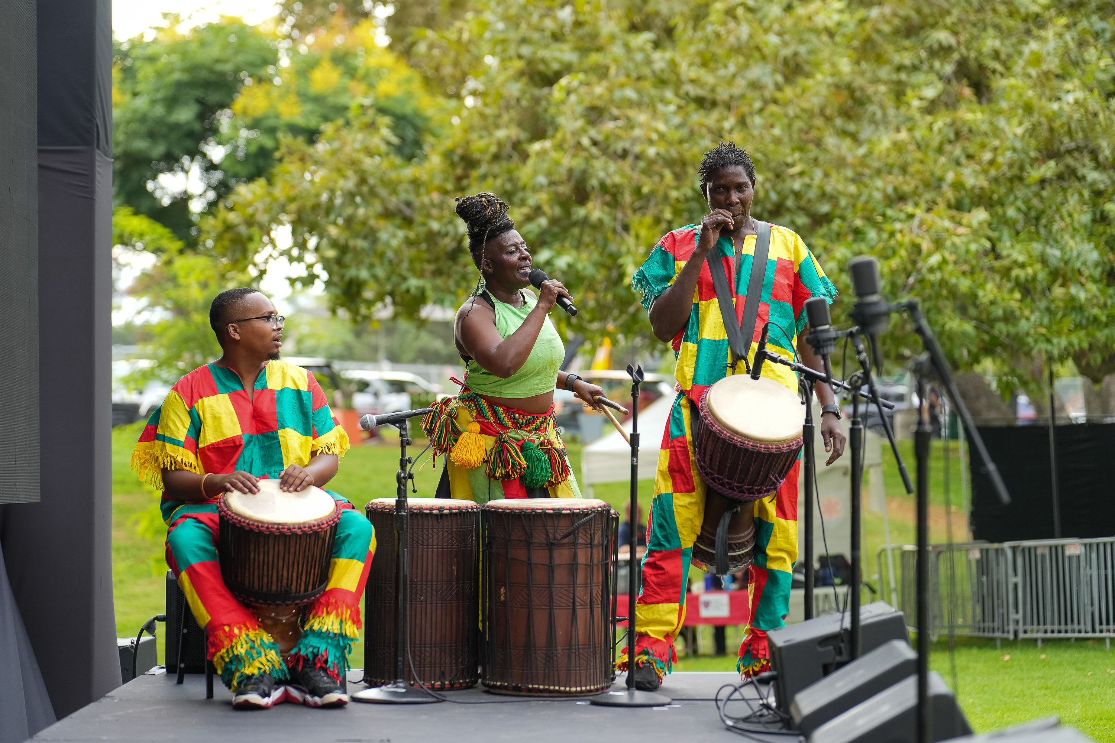
Pillar 2: Year of Creative Youth
Arts Education, Youth Development, Creative Career Pathways
LA County Arts Internship Program and Bloomberg Arts Internship Program provide paid internships for college and high school students.
Creative Wellbeing, providing healing arts engagement for youth and the adult caregivers.
Arts and Justice Youth Murals, engaging systems-involved youth in projects that build career skills, creative confidence, leadership.
NEW 2028 Olympic Arts Education Curriculum Guide, a collaboration with the Olympic Museum as resource for school districts, arts education organizations, libraries to engage youth.
Inner City Youth Orchestra, Barry J. Nidorf Secure Youth Treatment Facility (Sylmar)
  African Soul International performs in Altadena’s Loma Alta Park, part of Creative Wellbeing programming during LA Opera’s West Side Story live simulcast event.

Slide 13
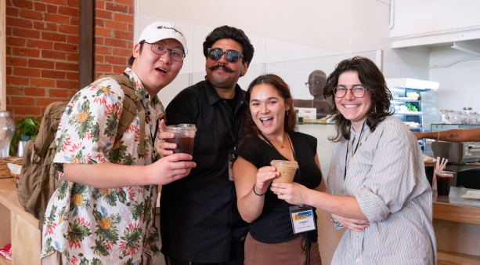
Pillar 2: Year of Creative Youth
Arts Education, Youth Development, Creative Career Pathways
Proposals:
School Arts Education, seeking funding to increase Advancement Grants for school districts to engage students in arts, field trips, cultural partnerships.
LA County Internship Program, seeking funding to expand paid arts internships.
2028 Poster Competition, builds on 2024 Cultural Olympiad Poster Competition for college-level arts school students and cultural diplomacy.
.
Inner City Youth Orchestra, Barry J. Nidorf Secure Youth Treatment Facility (Sylmar)
Arts Internship Summit, 2024

Slide 14
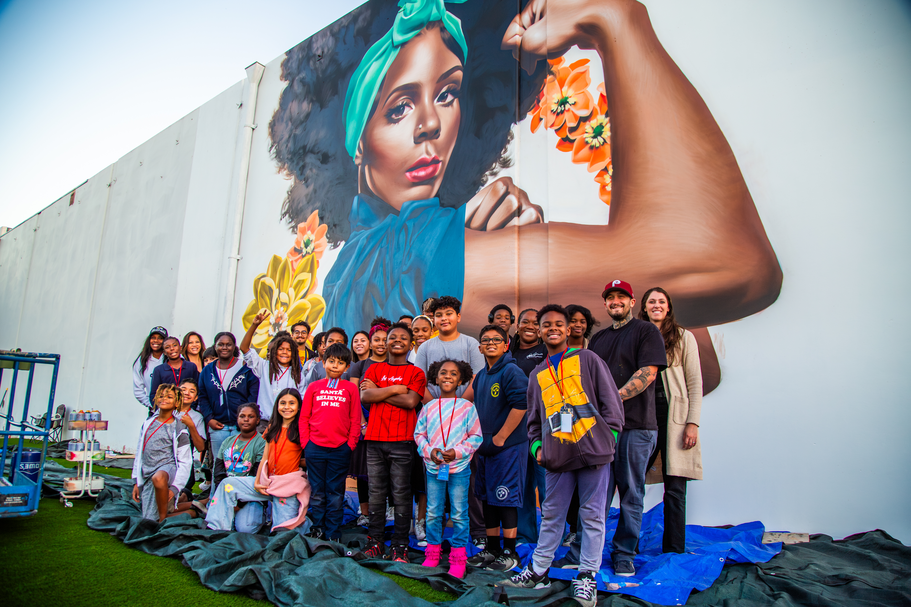
Pillar 3: Culture in Place
Civic Art, Cultural Hubs, Creative Placemaking and Keeping
Creative Strategist Artist-in-Residence, leveraging residencies to support 2028 Games and cross-sector themes, such as disability arts.
Cross-Sector Arts, continuing work supporting arts, health, and creative recovery in local communities.
LA County Public Art in Private Development (PAPD)-supported mural workshop in South LA with SoLA Impact.

Slide 15
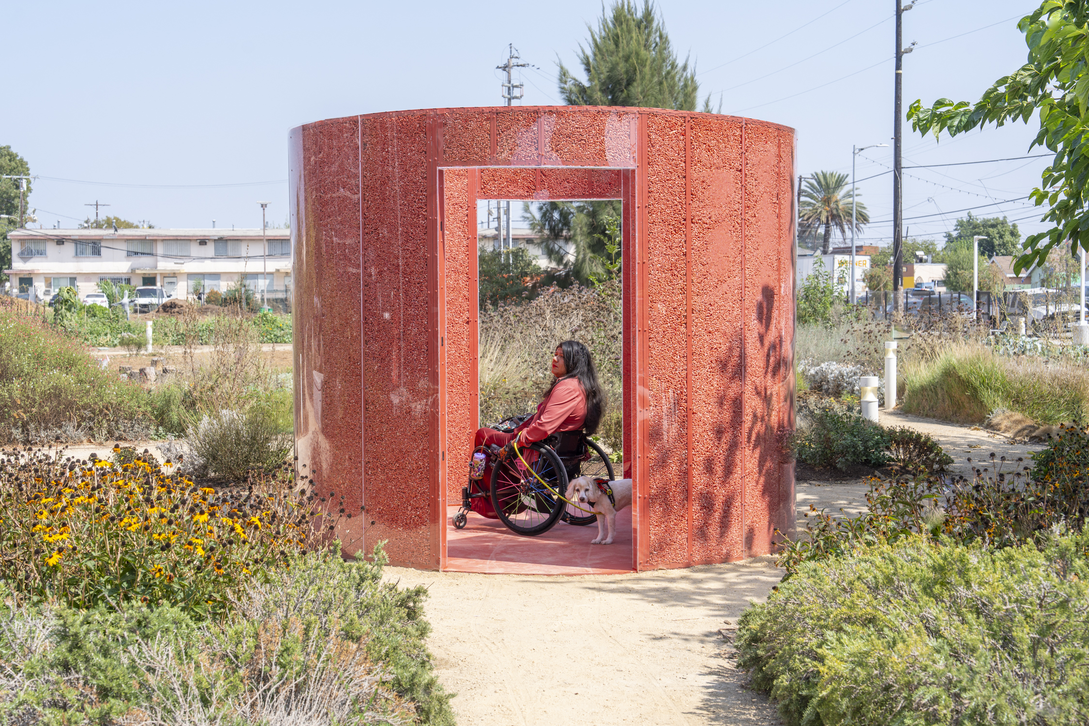
Pillar 3: Culture in Place
Civic Art, Cultural Hubs, Creative Placemaking and Keeping
Proposals:
First Peoples “We Are Still Here” Visibility Initiative, amplifying awareness of LA as home to one of the nation’s largest urban Native American populations.
Civic Art Conservation, preserving a historically and culturally significant mural commissioned for the 1984 Games.
Jazmín Urrea's El Barrilito de Fuego, 2024,
part of the Public Art in Private Development (PAPD) program

Slide 16
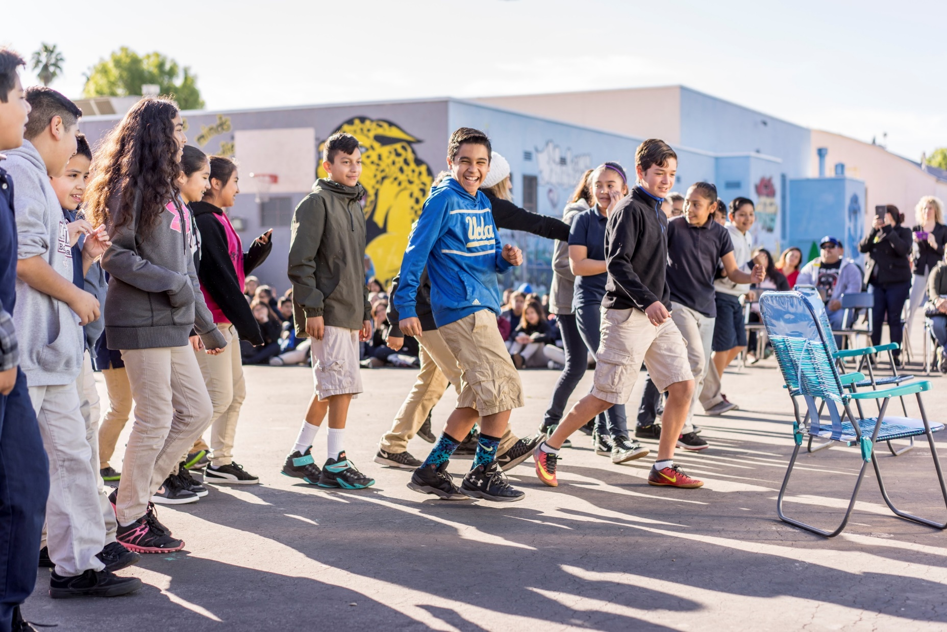
Pillar 4: Arts All Access
Regional Marketing, Communications, Storytelling
County of LA Outreach Campaign, will engage County departments to share information about arts and culture programming to reach communities.
Arts and Culture Toolkit for Cities and Unincorporated Areas, to support arts and culture across the County.
Exploring ways to collaborate with partners to strengthen regional arts communication and 2028 Cultural Program Evaluation.

Slide 17
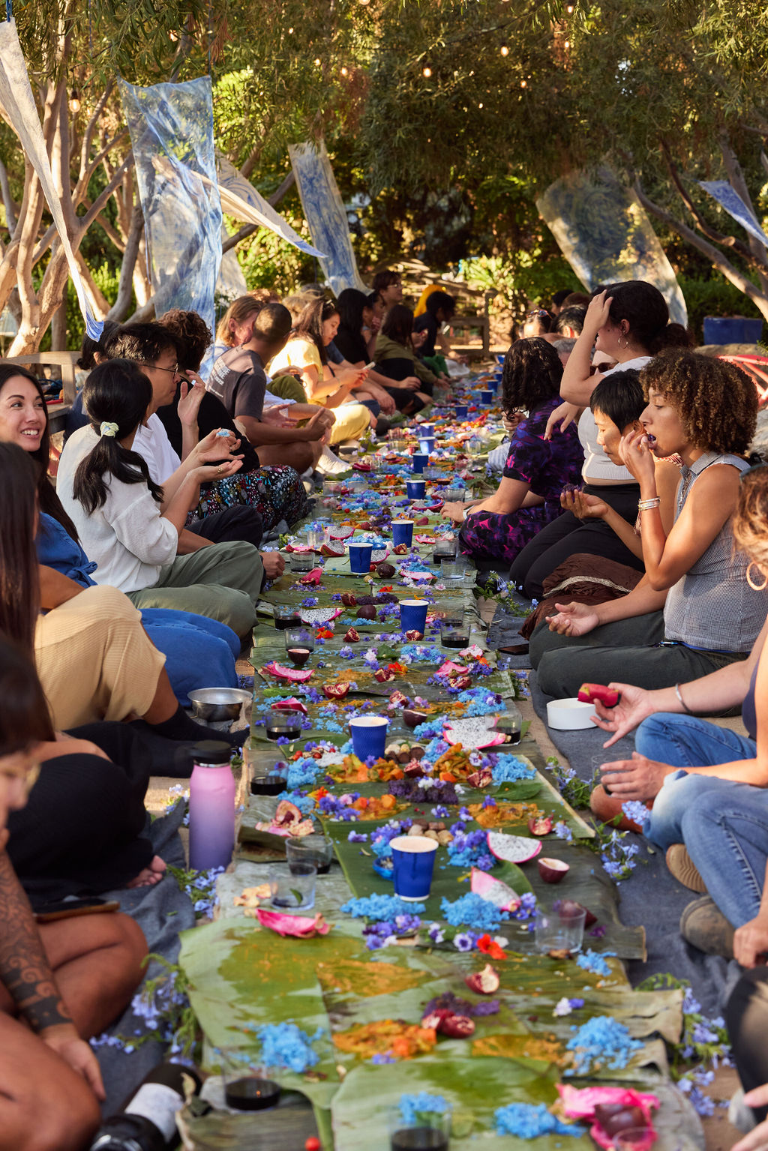
Next Steps, Support, and Partnership
Release 2028 Cultural Program Framework
Continue to cultivate funding and partnerships in 2026
Launch initiatives, grants, and projects in 2027
Continue to convene and engage key stakeholders building regional coordination and collaboration
Continue arts sector readiness and capacity building
Program delivery 2027-2028 for lasting legacy

Slide 18
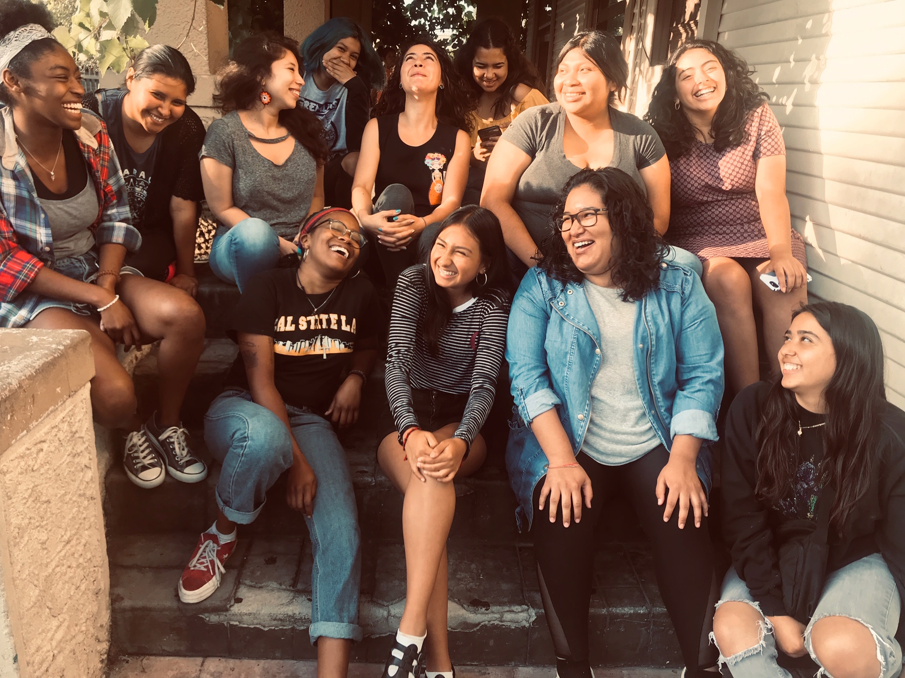
Beyond 2028: A Living Legacy
We Still Move aka Critical Mass Dance Company

Slide 19
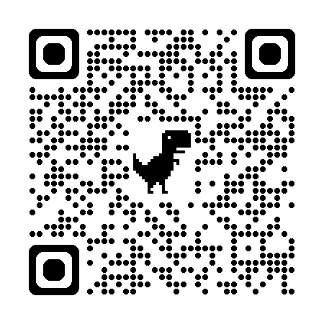
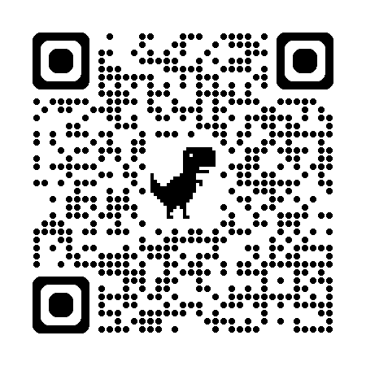
Thank you!
www.lacountyarts.org
Olympic and Paralympic Games Preparation

